Slide 1
CS2523 - Computer Organisation and Assembly Language
High Level Language to Assembly Conversion - Practice

Slide 2
Lets revise the last lecture

Slide 3
Loop Control
…
mov bx, num1 ; point bx to first number
mov cx, 10 ; load numbers count
l1: add ax, [bx] ; add number pointed by bx to ; ax
add bx, 2 ; l1 is label
sub cx, 1
jnz l1
mov [num1+20], ax ; write back result
…
num1: dw 1, 1, 1, 1, 1, 2, 2, 2, 2, 2
Notes:
The first line of code is move bx, num1. there difference here to note is that now num1 is not written like [num1] any more so it means that num1 is it self being referenced which is just the address or the offset and not the data so bx contains the address of num1.
Mov ax, [bx] means that move the contents of the memory location pointed by bx into ax so ax will now contain 5.
The line add bx, 2 means that the reason of adding 2 in bx is that we are reading a word so the last word was at a location of num1 and the new word will start ffrom num1 +2 or since it is pointed by bx so it will be bx +2 and also becuase we are using word interpretation
To perform the continuous execution we need a terminal condition to stop.
L1: add bx, 2; here l1 is label
sub cx,1
jnz l1; means jump if not zero and the jump will be to L1 it is defined as jump to the location of l1 if the zero flag is not set. Zero flag is set if the last mathematical or logical instruction has produced a zero in its destination. Although in the statement jnz l1 its not mentioned where to jump but the destination is implied inside this instruction which is the label l1.

Slide 4
C++
#include <iostream>
using namespace std;
int main()
{
short num1[10]={1, 1, 1, 1, 1, 2, 2, 2, 2, 2};
short *bx = num1;
short counter = 10;
short ax=0;
for(counter=10; counter>0; --counter)
{
ax = ax + *bx;
bx = bx + 1;
}
bx = num1;
bx = bx + 10;
cout<<"Sum of arrary elements: "<<ax<<endl;
*bx = ax;
return 0;
}

Slide 5
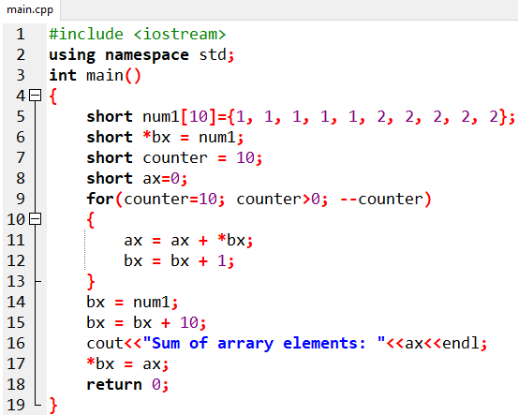
C++

Slide 6
Assembly
[org 0x100]
mov bx, num1 ; point bx to first number
mov cx, 10 ; load numbers count
l1: add ax, [bx] ; add number pointed by bx to ; ax
add bx, 2 ; l1 is label
sub cx, 1
jnz l1
mov [num1+20], ax ; write back result
num1: dw 1, 1, 1, 1, 1, 2, 2, 2, 2, 2
mov ax, 0x4c00
int 0x21

Slide 7
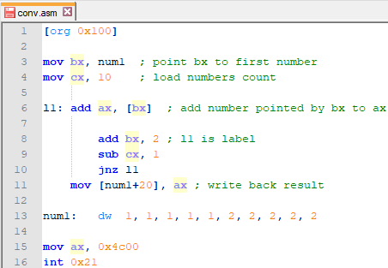
Assembly

Slide 8
The first line of code is move bx, num1. there difference here to note is that now num1 is not written like [num1] any more so it means that num1 is it self being referenced which is just the address or the offset and not the data so bx contains the address of num1.
Mov ax, [bx] means that move the contents of the memory location pointed by bx into ax so ax will now contain 5.
The line add bx, 2 means that the reason of adding 2 in bx is that we are reading a word so the last word was at a location of num1 and the new word will start ffrom num1 +2 or since it is pointed by bx so it will be bx +2 and also becuase we are using word interpretation
To perform the continuous execution we need a terminal condition to stop.
L1: add bx, 2; here l1 is label
sub cx,1
jnz l1; means jump if not zero and the jump will be to L1 it is defined as jump to the location of l1 if the zero flag is not set. Zero flag is set if the last mathematical or logical instruction has produced a zero in its destination. Although in the statement jnz l1 its not mentioned where to jump but the destination is implied inside this instruction which is the label l1.

